Slide 1
An Analysis of Olympic Figure Skating Success by Age and Country
By Deme Khamken

Slide 2
Table of Contents
Background Info (slide 3)
Motivation (slide 4-6)
Data Questions & Focus (slide 7)
The Process (slide 8)
Dashboard (Power BI)
Conclusion (slide 10-11)
Sources (slide 12)

Slide 3
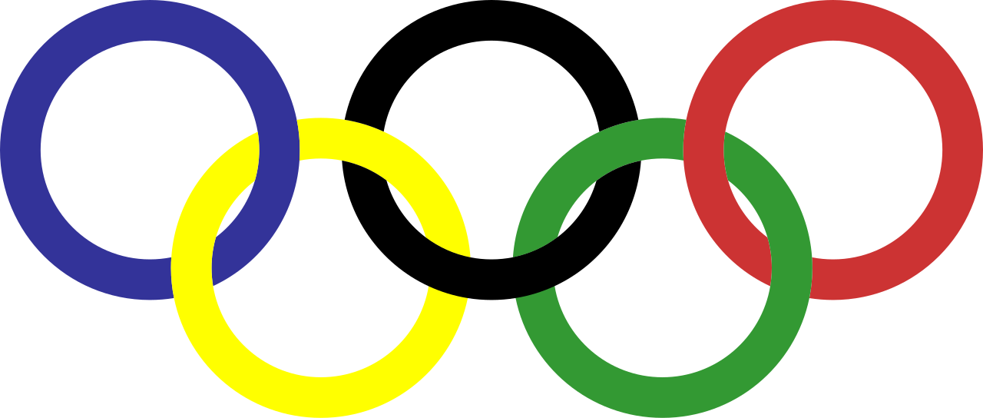
Background Info
The Olympic Games is the largest international sports festival in the world. Figure skating was first introduced in the 1908 Summer Olympic Games and moved to become a part of the Winter Games in 1924. It was one of the first sports with a category for women and the only Winter Olympic sport with women competitors until 1936.
Source: Slide 11.4

Slide 4

Motivation
Why did I choose this topic? Why does this matter? Few reasons highlighted below:
Personal Experience Competitive figure skater for 10+ years with dreams of competing in the Olympics
Understanding the Olympic Goal What is the ultimate goal of the Olympics?
Recent Controversy 15 yo Russian skater favored to win 2022 Beijing Olympics tested positive for illegal drug

Slide 5
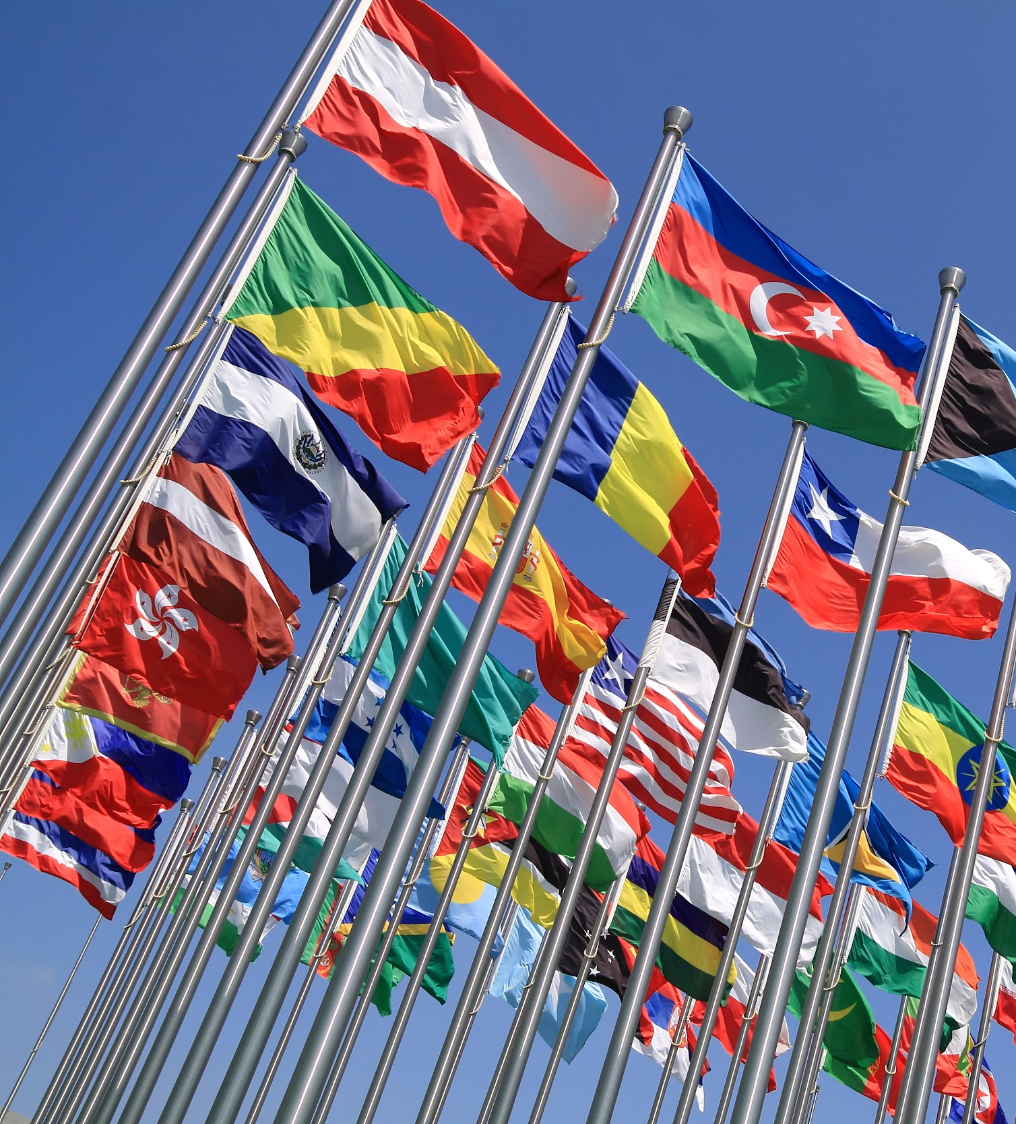
The Olympic Games is an international sports festival with the ultimate goals to cultivate human beings, through sport, and contribute to world peace. Olympism is a philosophy of life, exalting, and combining in a balanced whole the qualities of body, will, and mind.
Olympic Goal
Source: Slide 11.2

Slide 6
Blending sport with culture and education, Olympism seeks to create a way of life based on joy found in effort, the educational value of good example, and respect for universal fundamental ethical principles.
Source: Slide 11.2

Slide 7
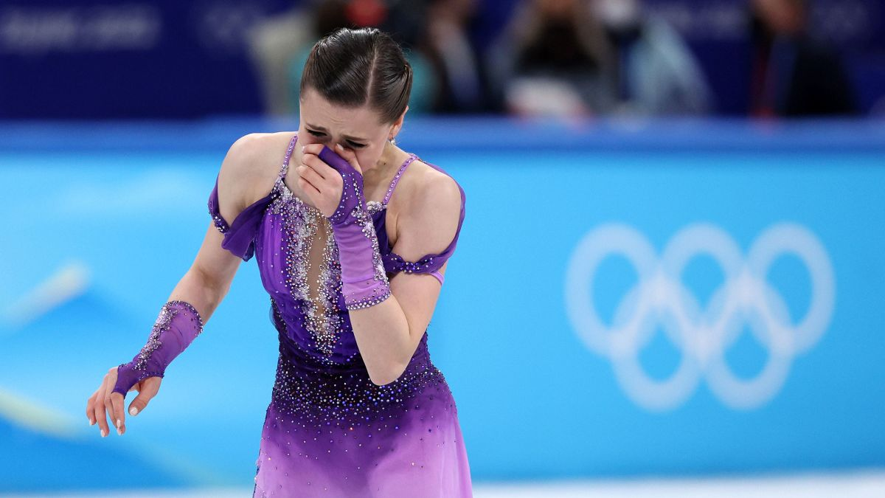
2022 Controversy & Doping Scandal
15 yo Russian skater, Kamila Valieva, favored to win gold at 2022 Beijing Olympics tested positive for an illegal drug; the ISU’s (international skating union) decision to raise the minimum age for qualification to 17 yo was accelerated post scandal, March 2022.
“..we urgently needed to change to protect the physical, mental, and emotional health of athletes.”
Increasing the age minimum to 17 decreases the risk of injury “if training loads are modified during times of rapid growth” and allows skaters to “expand on their social and emotional skill development” according to the proposal.
Source: Slide 11.3

Slide 8
Data Questions & Focus
Which countries have the most successful figure skating training programs that emulate the Olympic goal which could benefit/contribute to the overall health of an athlete?
In the past decade of Winter Olympic games, which countries produced the most successful figure skaters who are of the the new qualification age?
In the past decade of Winter Olympic games, which countries may have a need for training program restructuring (countries with athletes under qualification age)?

Slide 9
The Process
How I gathered and analyzed the data
Web scrape using Python Scraped and cleaned data from the official Olympics website to find the result of all medalists from the Winter Olympics beginning in Chamonix 1924.
Power BI Used to build dashboards and filters with data of all medalists to analyze which countries had athletes who were of qualification age or older when winning a medal, focusing on the most recent Olympic Games from 2010 to 2022.

Slide 10
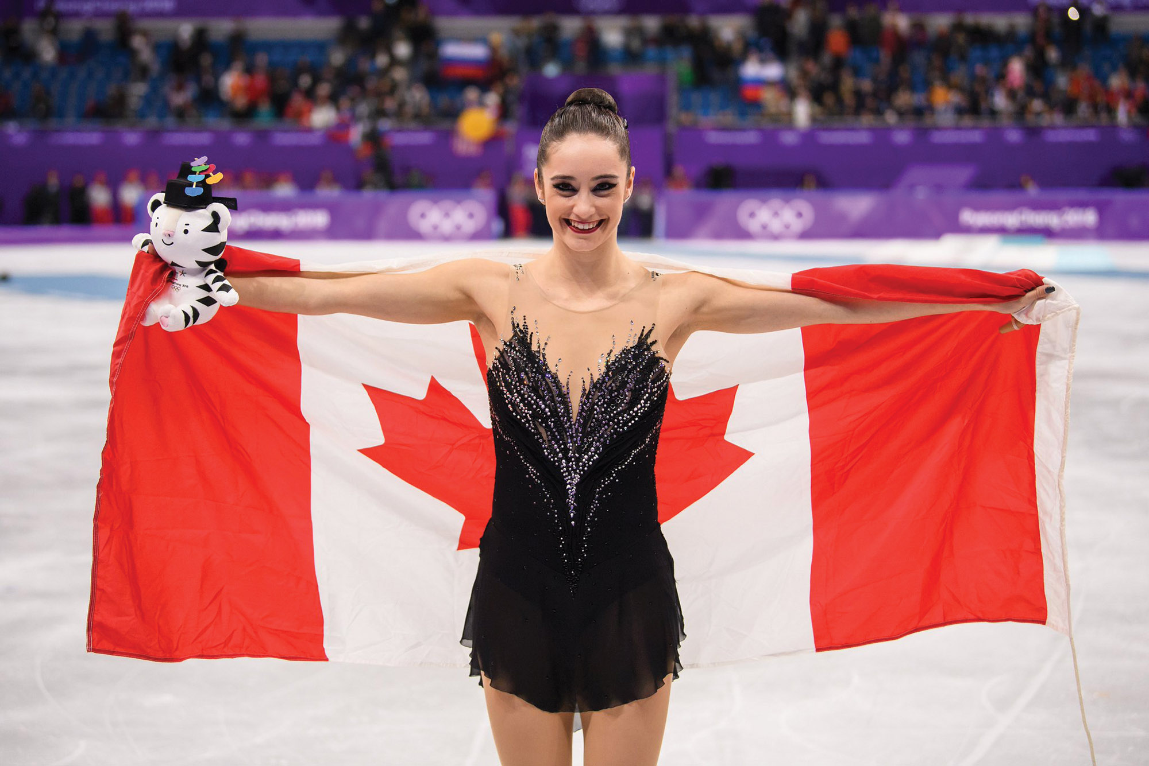
Conclusion- Women
66.7% of medalists from 2010-2022 were of or older than the qualification age
Italy had the medalist with the oldest age at 27 yo
Of the 66.7% (8 qualified aged) medalists:
12.5% Italian athletes (avg age 27)
12.5% Russian athletes (avg age 18)
25.0% Canadian athletes (avg age 23)
25.0% Korean athletes (avg age 21)
25.0% Japanese athletes (avg age 20)
Russia had the medalist with the youngest age at 15 yo
Of the 4 under qualified-aged medalists:
100.0% are Russian athletes (avg age 17)

Slide 11
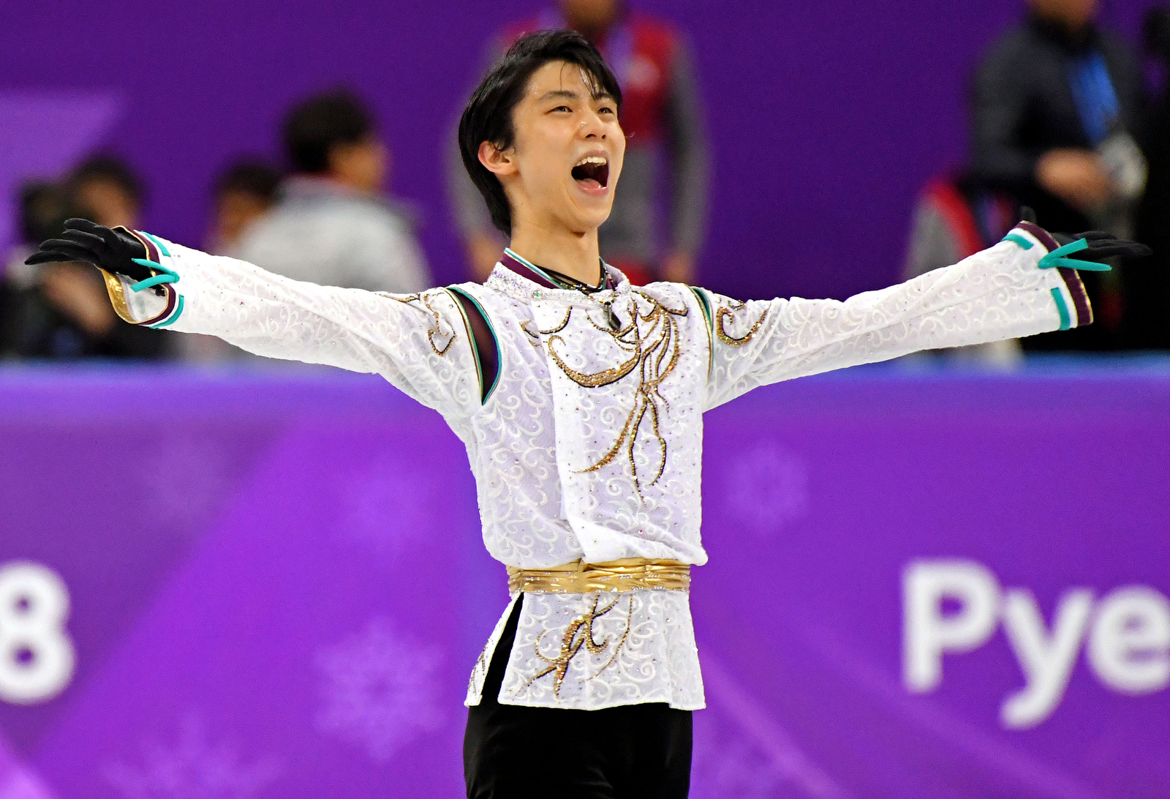
Conclusion- Men
Russia had the medalist with the oldest age at 28 yo
No countries had medalist that were under qualification age.
All 12 medalist were of or older than the qualification age
8.33% Kazakhstan (avg age 20)
8.33% Canadian (avg age 23)
8.33% Spanish (avg age 27)
8.33% Russian (avg age 28)
16.67% American (avg age 23)
50.0% Japanese (avg age 21)

Slide 12
Sources
https://olympics.com/en/olympic-games/olympic-results
https://olympics.com/ioc/beyond-the-games
https://olympics.nbcsports.com/2022/05/02/figure-skating-age-minimum-international-skating-union-isu-proposal/
https://usopm.org/hall-of-fame/figure-skating/#:~:text=Figure%20skating%20is%20one%20of,with%20women%20competitors%20until%201936.
https://en.wikipedia.org/wiki/List_of_Olympic_medalists_in_figure_skating_by_age

Slide 13
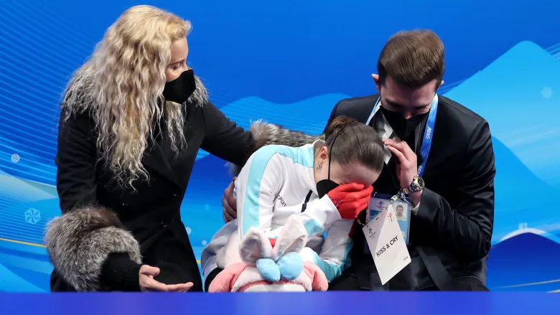
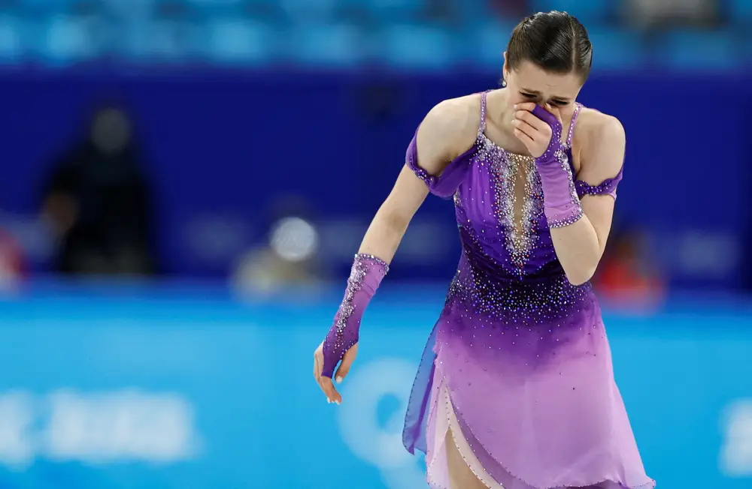
2022 Figure Skating Controversy & Doping Scandal
15 yo Russian skater, Kamila Valieva, favored to win gold at 2022 Beijing Olympics tested positive for an illegal drug; the decision to raise the minimum age for qualification to 17 yo was accelerated post scandal.
“..urgently needed to change to protect the physical, mental, and emotional health of athletes.”
Increasing the age minimum to 17 decreases the risk of injury “if training loads are modified during times of rapid growth” and allows skaters to “expand on their social and emotional skill development” according to the proposal.
Source: https://olympics.nbcsports.com/2022/05/02/figure-skating-age-minimum-international-skating-union-isu-proposal/

